Slide 1

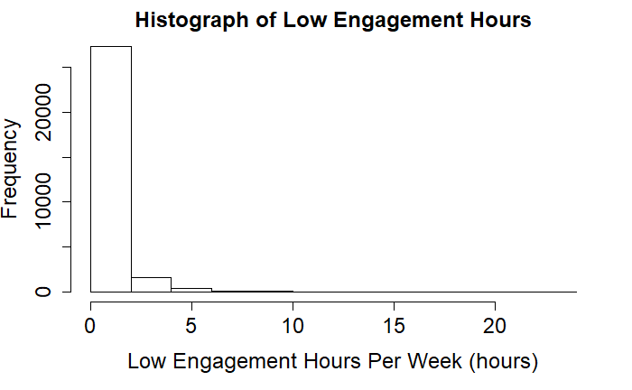

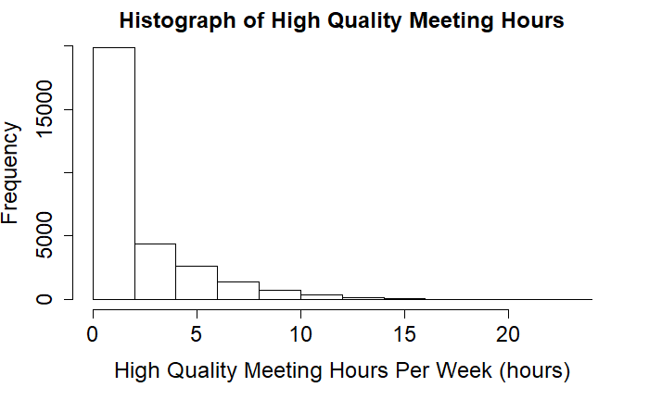
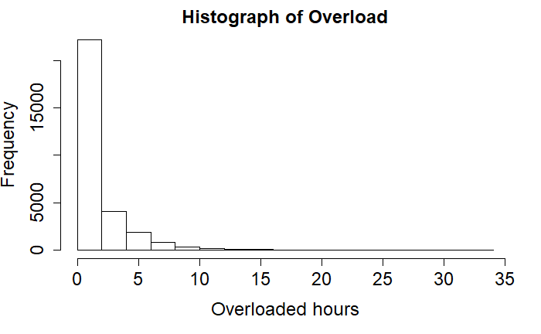

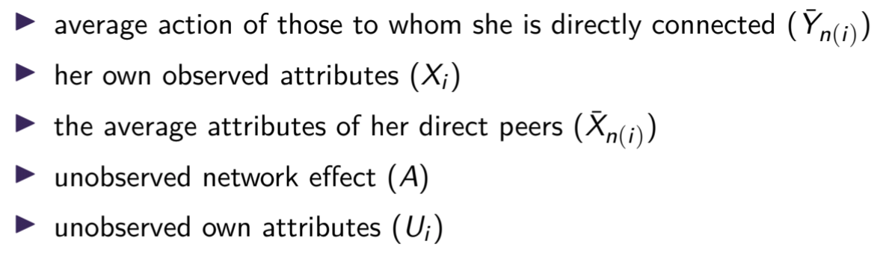
Measuring Peer Effects On Behaviors Using Company Networks
Ankit Tandon
STAT 567 Statistical analysis of social network data University of Washington
Purpose
Assumptions/Limitations
Results
Analyze how employees communicate with one another through digital traces such as email exchanges and co-attendance of meetings.
Analyze how these communication traces impact employee performance and productivity on the basis of key performance indicators.
Understand if there is an effect on employee's disengagement if they interact with other disengaged peers
Naïve in considering just influence of direct peers but not peers of peers.
Reflection Problem – we can identify whether a peer effect exists and is statistically significant but without experimentation there is no way to make a causal conclusion.
Models with just peer effects
Variable | Estimate | P-Value
High quality meeting hours peer effect | -0.36263 | 0.000717 ***
High quality meeting hours peer effect (previous week) | -0.14462 | 0.171994
Low Engagement Hours peer effect | 0.388267 | 0.00001 ***
Low Engagement Hours peer effect (previous week) | 0.274413 | 0.00001 ***
Overload peer effect | 0.290180 | 0.00001 ***
Overload peer effect (previous week) | 0.133139 | 0.00001 ***
Exploratory Data Analysis
Data Overview
3 outcome variables
Email and Meeting communication data of employees in a global hardware manufacturing firm from January 2011 to June 2011.
Approximately 1.3 million emails were exchanged and 233k meetings were recorded
1286 employees worth of information, including their management hierarchy, team, title, and role definition, as well as 130 additional KPIs.
Low engagement hours is a combination of time spent multi-tasking in meetings, attending double-booked meetings, attending redundant meetings, and interruptions during focus time.
High Quality Meetings are defined as ones where there is no redundancy, conflicts, multi-tasking, and meet criteria for attendance and duration.
Models with peer effects and agent’s attributes and controls
Variable | Estimate | P-Value
High quality meeting hours peer effect | -0.175472 | 0.00683 ***
High quality meeting hours peer effect (previous week) | 0.126239 | 0.04887 *
High quality meeting hours (previous week) | 0.797738 | 0.00001 ***
Low Engagement Hours peer effect | 0.045848 | 0.00001 ***
Low Engagement Hours peer effect (previous week) | 0.121413 | 0.00001 ***
Low Engagement Hours (previous week) | 0.695591 | 0.00001 ***
Overload peer effect | 0 | 0 ***
Overload peer effect (previous week) | 0 | 0 ***
Overload (previous week) | 0 | 0 ***
Linear in Means Model
Overload is time spent working outside of regularly defined working hours.
Y_{i} = Measured outcome of agent _{i}
Person Level Covariates
Distribution of employee count by Function
Distribution of employee count by Level
Level Designation | Count of Employees
G&A | 216
HR | 19
Marketing | 73
Operations | 509
Product Management | 22
R&D | 203
Sales | 244
Level Designation | Count of Employees
Director | 73
Executive | 16
Junior IC | 460
Manager | 214
Senior Executive | 11
Senior IC | 174
Support | 338
Research Questions
Distribution of employee count by Executive
Question #1: Is there a significant peer effect on low engagement hours?
Question #2: Is there a significant peer effect on high quality meeting hours?
Question #3: Is there a significant peer effect on overload?
Distribution of employee count by Region
Level Designation | Count of Employees
Brown | 191
Davis | 35
Garcia | 22
Johnson | 204
Jones | 147
Lee | 202
Miller | 52
Rodriguez | 19
Smith | 399
Wilson | 15
Level Designation | Count of Employees
Central | 572
East | 223
North | 4
South | 365
Southwest | 4
West | 118
Next Steps
Add in exogenous effects like manager’s high-quality meeting hours, low engagement hours, and overload
Alter outcome variables by running model on employees with exhibited behavior only.

